Slide 1
Feature extraction for biomedical imaging applications
EpiGenResSchool image computing
19.05.2021

Slide 2
Agenda
Introduction
Statistical features
GLCM features
Single-cell features
Other Features
Recommendation

Slide 3
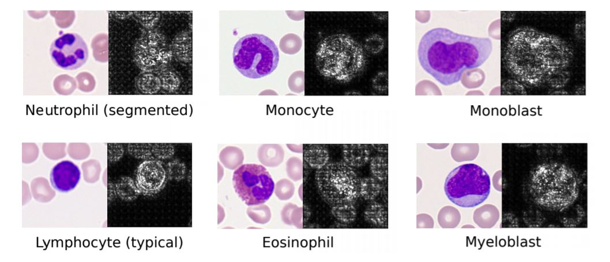
Motivation
While deep learning has revolutionized the field, it still lacks in interpretability
In many applications, the amount of existing annotated data is limited.
For proving that your deep learning model is working, a great starting point is to compare it with classical methods
Image & Saliency map*
*Human-level recognition of blast cells in acute myeloid leukemia with convolutional neural networks (Matek et al. 2019)

Slide 4
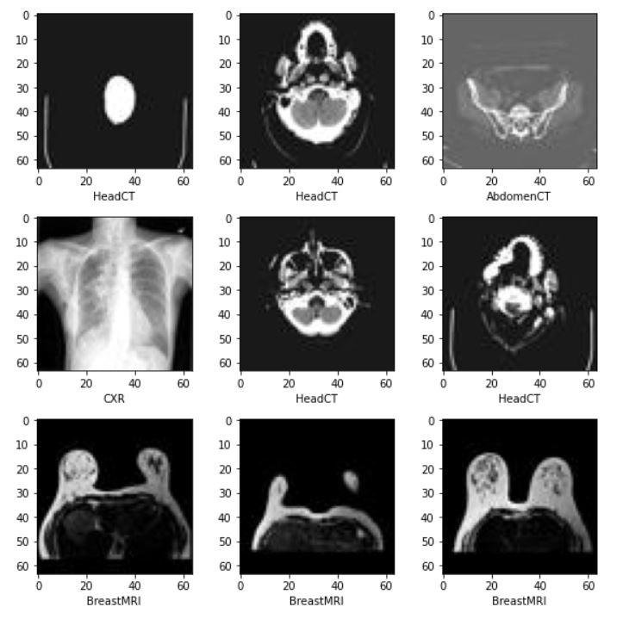
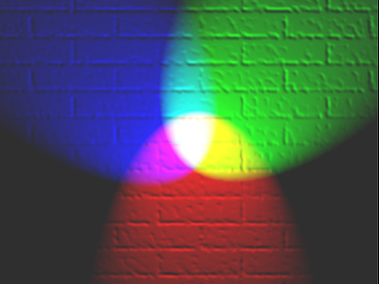
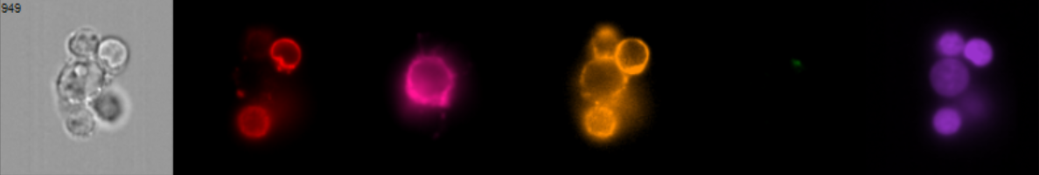
Typical Image shapes
Grey scale
(H*W)
RGB
(H*W*3)
Multi-channel
(H*W*C)
https://en.wikipedia.org/wiki/RGB_color_model#/media/File:RGB_illumination.jpg

Slide 5
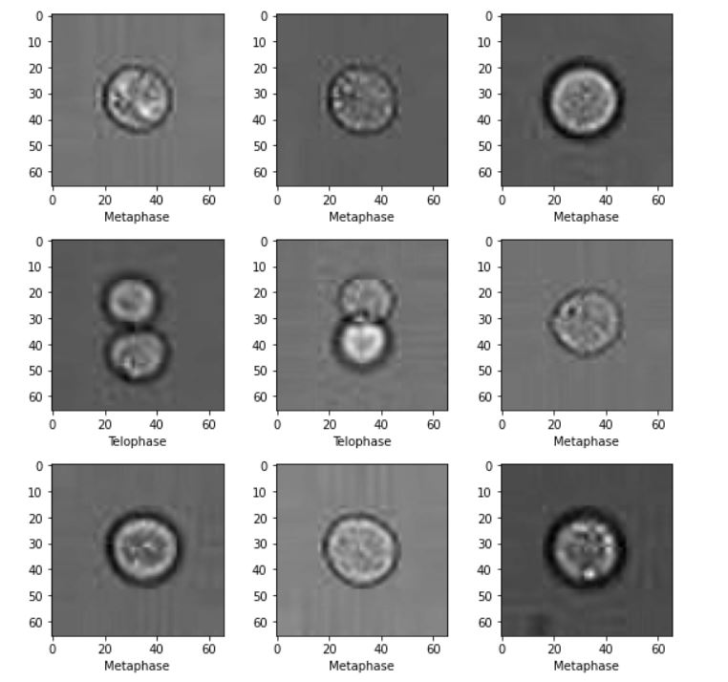
How a sample look like?
Image
Label
Singlet
Doublet

Slide 6
Naïve Approach
Pixels
Labels
(im_1, label_1)
(im_2, label_2)
.
.
.
.
.
.
(im_3, label_3)
.
.
.
The problem is the dimension of the data. For example, a small image of 64*64*3 will become a 12288 dimensional vector.
(im_n, label-n)

Slide 7
Question
What makes each image distinguishable?

Slide 8
Agenda
Introduction
Statistical features
GLCM features
Single-cell features
Other Features
Recommendation

Slide 9
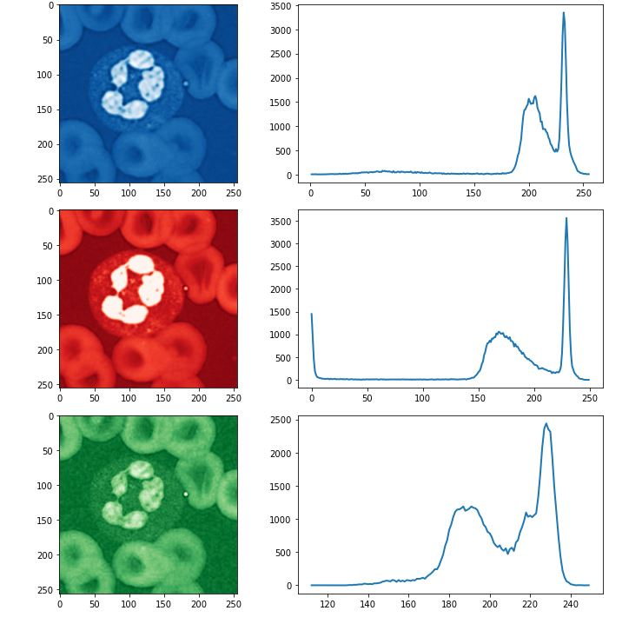
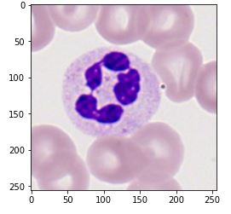
Image Histogram

Slide 10
Statistical features
For every image, calculate the main statistical features (per channel)
Min pixel intensity Mean
Standard Deviation, kurtosis
Skewness Shannon entropy
Percentiles Max pixel intensity
Sum of pixel intensities Energy of signal (sum of squared pixels)
This also works for time series, sequential data an so on…

Slide 11
Example (MedNIST)
Five Class classification
Abdomen (0)
breast MRI (1)
CXR (2)
Chest (3)
Hand (4)
Head (5)
Each class contain 2000 samples
Each image is 64*64
To make it more challenging, we add two more channels using Gaussian noise

Slide 12
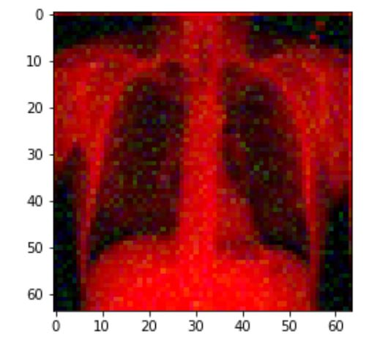
Example (MedNIST)
To make a more challenging task, we add two more channels using Gaussian noise
The new image is an RGB image with 64*64*3 dimension
We extract statistical features for each channel which leads to 51 features per sample
Random Forest classifier was trained on the data
25% of the data was used for test

Slide 13
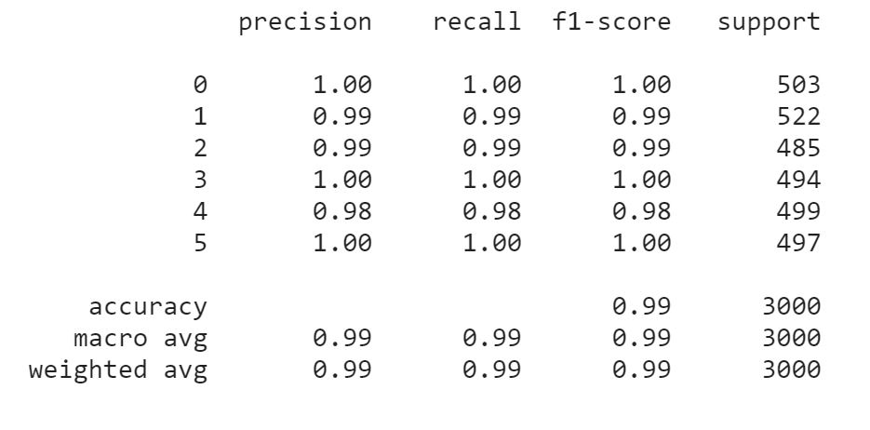
Results (MedNIST)

Slide 14
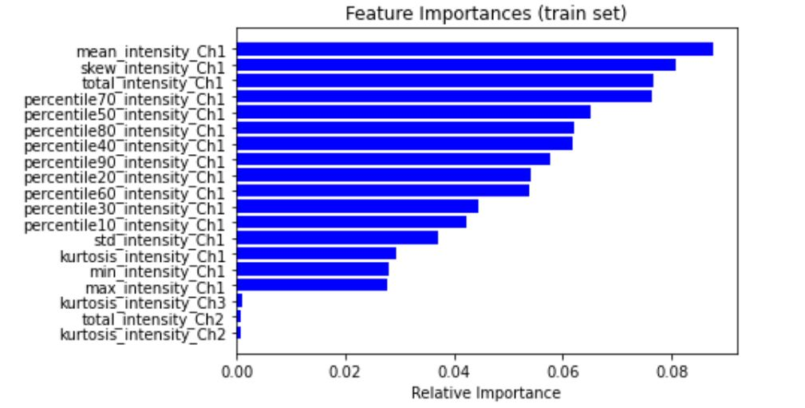
Results (MedNIST)

Slide 15
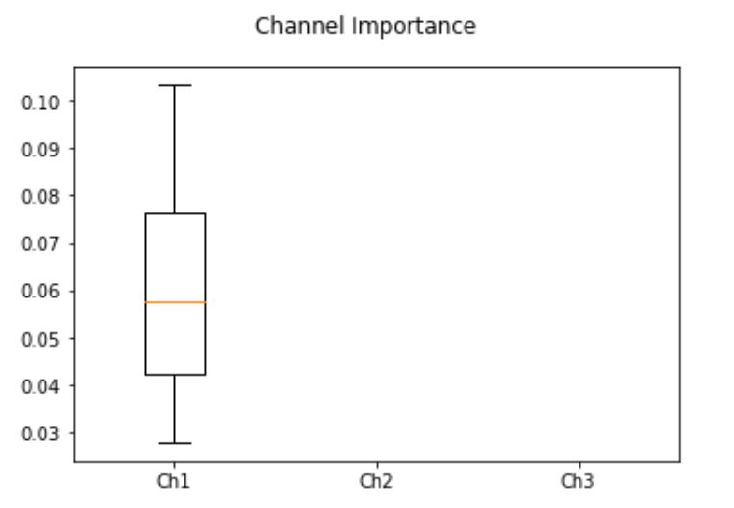
Results (MedNIST)

Slide 16
Agenda
Introduction
Statistical features
GLCM features
Single-cell features
Other Features
Recommendation

Slide 17
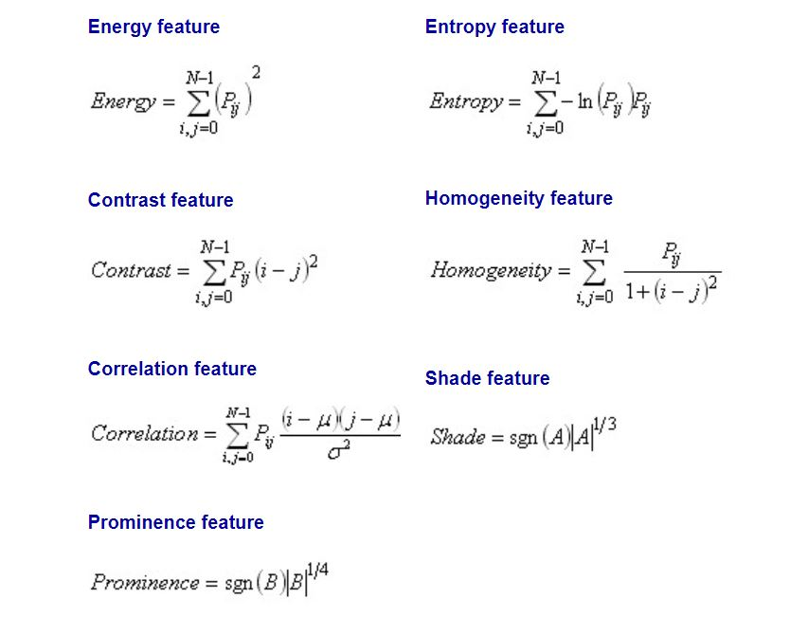
GLCM* features
GLCM or Haralick features measures the texture related features in the greyscale image
These features are calculated really fast, and work very well with florescent images.
https://scikit-image.org/docs/dev/auto_examples/features_detection/plot_glcm.html
Haralick, RM.; Shanmugam, K., “Textural features for image classification” IEEE Transactions on systems, man, and cybernetics 6 (1973): 610-621. DOI:10.1109/TSMC.1973.4309314

Slide 18
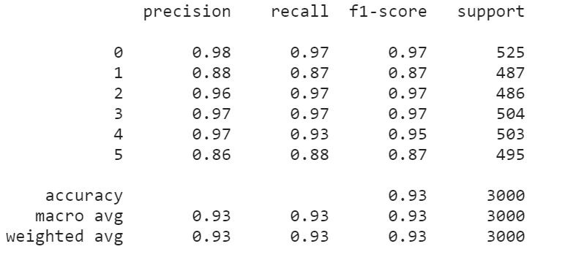
GLCM* features

Slide 19
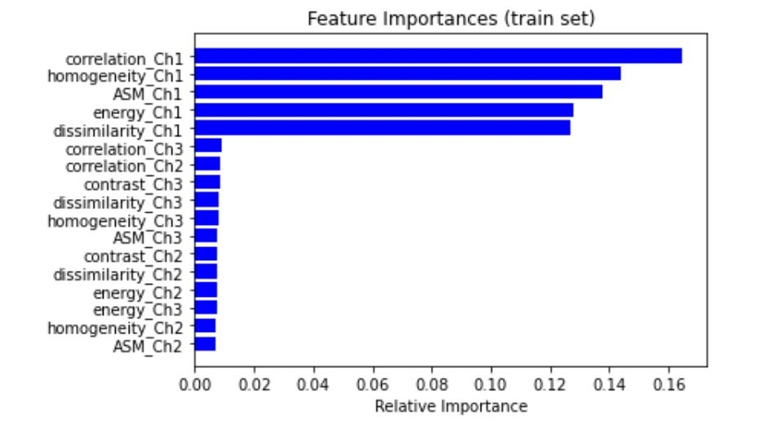
GLCM* features

Slide 20
Agenda
Introduction
Statistical features
GLCM features
Single-cell features
Other Features
Recommendation

Slide 21
Morphology Features
Software companies such as CellProfiler, Fiji, ImageJ and … are focused on finding the best morphology features.
Normally you can find a great deal of inspiration from their documentations
In the following, we overview some of the main morphology features

Slide 22
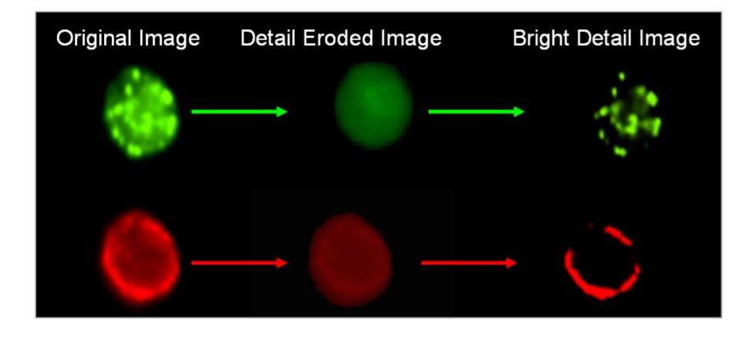
Morphology Features
https://scikit-image.org/docs/dev/api/skimage.measure.html#skimage.measure.regionprops
Here is a list of possible features
Area Centroid
BoundingBox MajorAxisLength
MinorAxisLength Eccentricity
Orientation ConvexHull
ConvexImage ConvexArea
FilledImage FilledArea
EulerNumber Extrema
EquivDiameter Solidity
Extent PixelList
Colocalization
Many of these local features are created based on creativity and understanding of the biology.

Slide 23
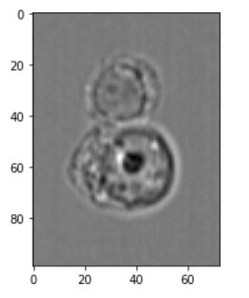
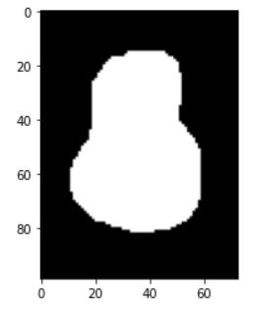
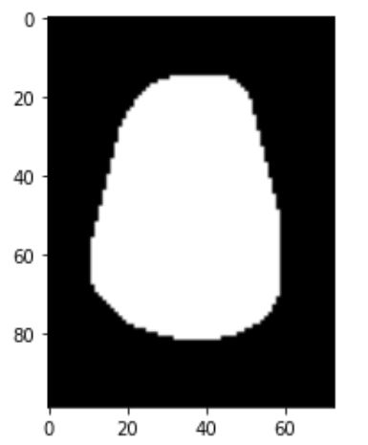
Masks
Main Image
Mask
Convex Hall

Slide 24
Morphology Features
Area = sum of pixel values of the mask
Equivalent diameter = The diameter of a circle with the same area as the region.
Convex area =Number of pixels of convex hull image, which is the smallest convex polygon that encloses the region.
Solidity = Ratio of pixels in the region to pixels of the convex hull image.
Max Feret diameter : the longest distance between points around a region’s convex hull contour
Moments = Spatial moments
Mask
Convex Hall

Slide 25
Morphology Features
Background average pixel value
Bounding Box area, width, height
Centroids
Distance between centroids
Extent: Ratio of pixels in the region to pixels in the total bounding box. Computed as [area / (H * W) ]
Height
Width

Slide 26
Morphology Features
Area of the ellipse
Major Axis
Minor Axis
Aspect Ratio (Minor/Major Axis)
Major Axis
Minor Axis

Slide 27
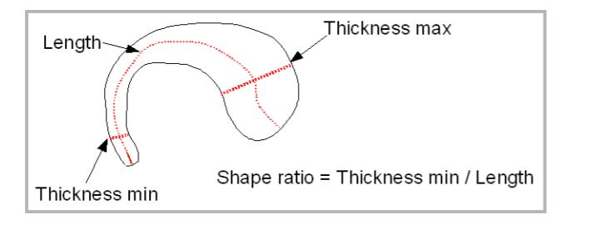
Skeleon Features

Slide 28
Bright Detail Intensity

Slide 29
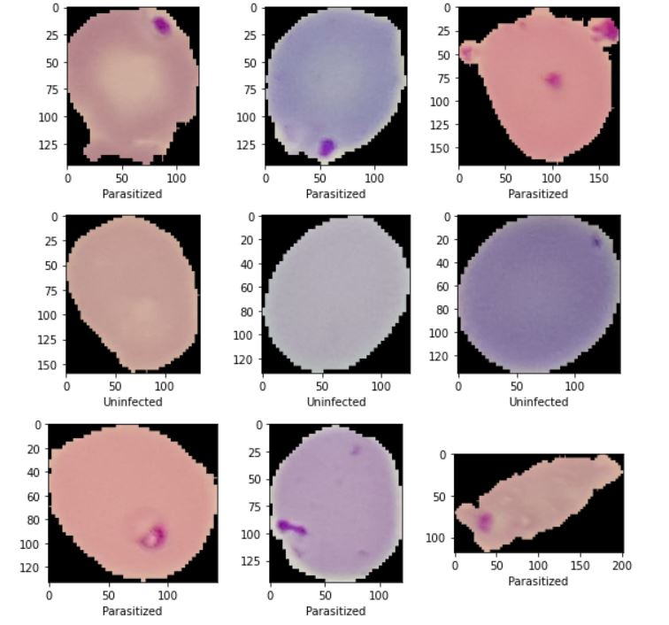
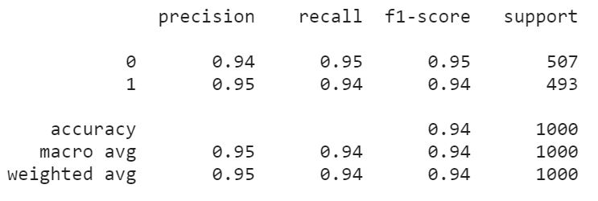
Example (Plasmodium)
two Class classification
Uninfected
Infected
Each class contains 2000 samples
Images have different sizes
With only glcm features and statistical features, we only reached 82% of accuracy
By adding the morphology features we got 14% improvement

Slide 30
Agenda
Introduction
Statistical features
GLCM features
Single-cell features
Other Features
Recommendation

Slide 31
Other features
While the mentioned features are useful, they wont be completely helpful in many challenging datasets.
For years (and still) the computer vision community were concentrated on finding the best set of features for vision related tasks.
Here is a sample of other feature extraction methods which can be used to reach high level of accuracy in many tasks
Daisy
Haar like features
Hog
BRIEF
SIFT
While these methods are useful, they again lead to a high number of features. Also the interpretability becomes limited while using these methods

Slide 32
Agenda
Introduction
Statistical features
GLCM features
Single-cell features
Other Features
Recommendation

Slide 33
Recommendation
In case you are looking for interpretable features, statistical features + morphology features can be a great starting point
For best performance, I suggest to use Statistical Features + GLCM + Hu Moments + Hog Features
As this combination leads to a high number of features, feature selection methods are recommended as many of the features from different methods are correlated
Random forest seems working very well with many of these features

Slide 34
Recommendation
Statistical Features GLCM
Hu Moments
Hog Features
Feature Selection Methods
such as Logistic Regression with L1 loss
RF and SVM have been showed to work well with image features
Feature Extraction
Dimensionality Reduction
Classification
Downstream analysis
Deep Learning

Slide 35
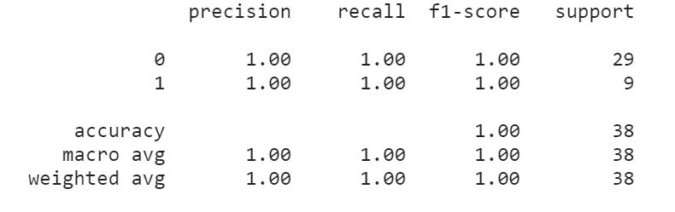
Example (cell cycle)
Two Class classification
Metaphase (68 samples)
Telophase (27 samples)
With only glcm features and statistical features, we only reached 70% of f1-score
By adding Hu Moments and Hog features we could improve by lot!

Slide 36
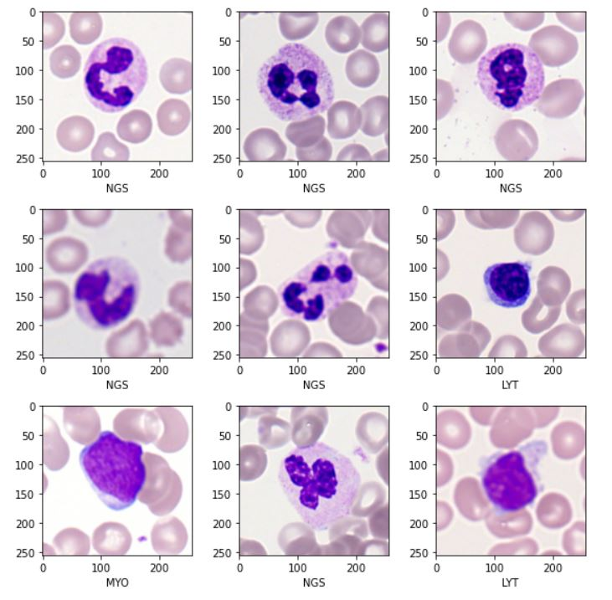
Example (White Blood Cells)
Three Class classification
LYT (787 samples)
MYO (653 samples)
NGS (1697 samples)
Features:
Statistical
GLCM
Moments
HOG
Used grid search for best feature selection (lasso) and random forest as the classifier

Slide 37
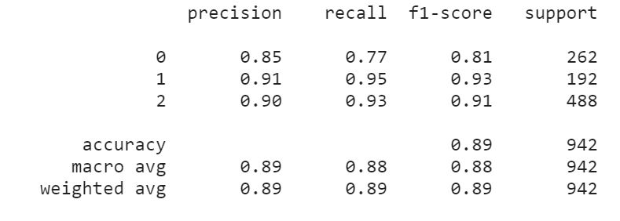
Example (White Blood Cells)

Slide 38
Thanks for your attention ☺
Any question?

